Slide 1

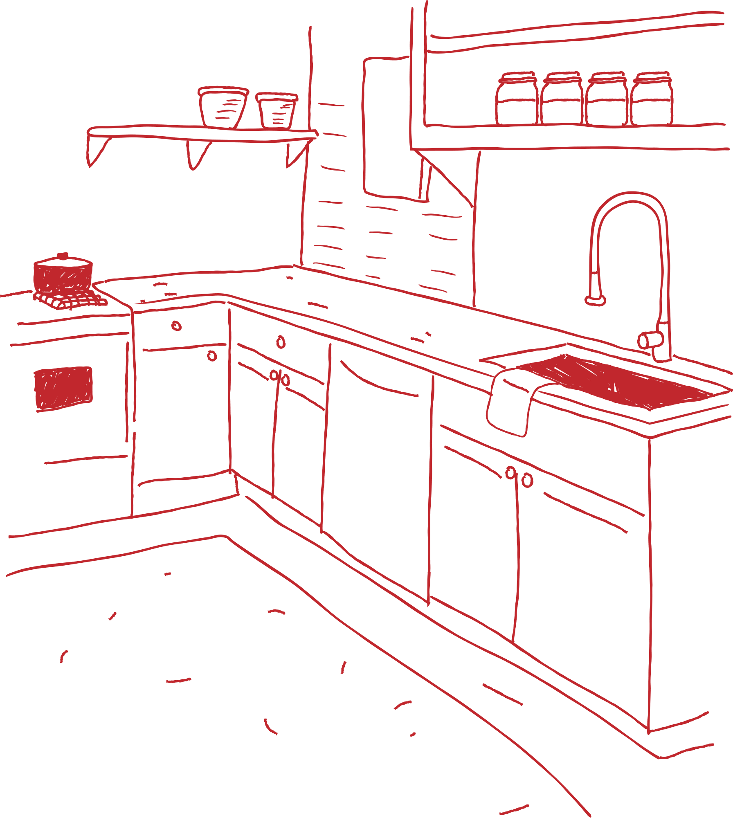




MEAL
MATE
SUBJECT: CS691
Computer Science
Project 1

Slide 2


AGENDA
Team Member Roles and Responsiblities
Improvements made from Professor Feedback
Project Description
Team working agreement
Personas (at least 3)
MVP
Technologies
Algorithms
Diagrams
Architecture Diagrams, Context Diagram, ER Diagrams, Sequence
Diagram, State Diagrams, Cl
Sprint 1 Recap
Product Backlog

Slide 3
AGENDA
Stories or Tasks committed for this Sprint ( Storie and Acceptance Criteria)
Sprint Summary
Test Cases
Stories completed and Stories not completed
API usage in the Application
Metrics
Team velocity
Burndown Charts
Completed/Committed Ratio
Retrospective
Sprint Backlog (Stories planned for sprint 3)
Project Demo ( current sprint)
Github link

Slide 4
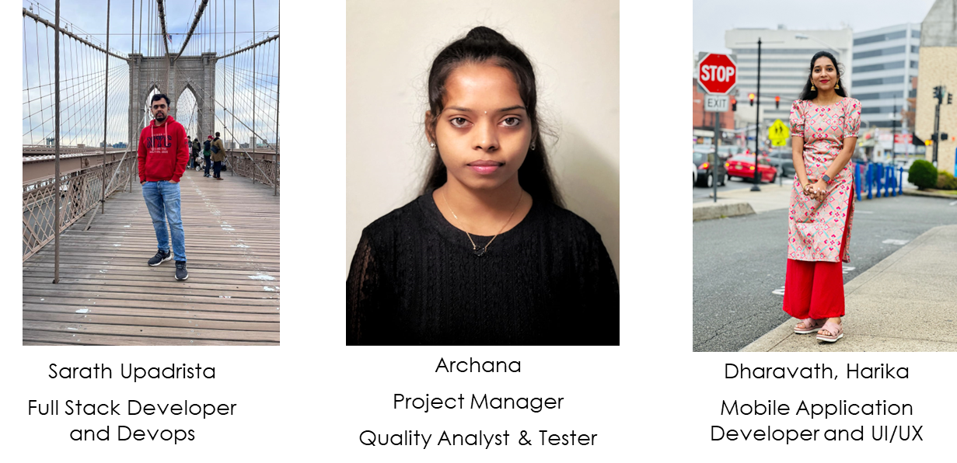
Team Member Roles

Slide 5
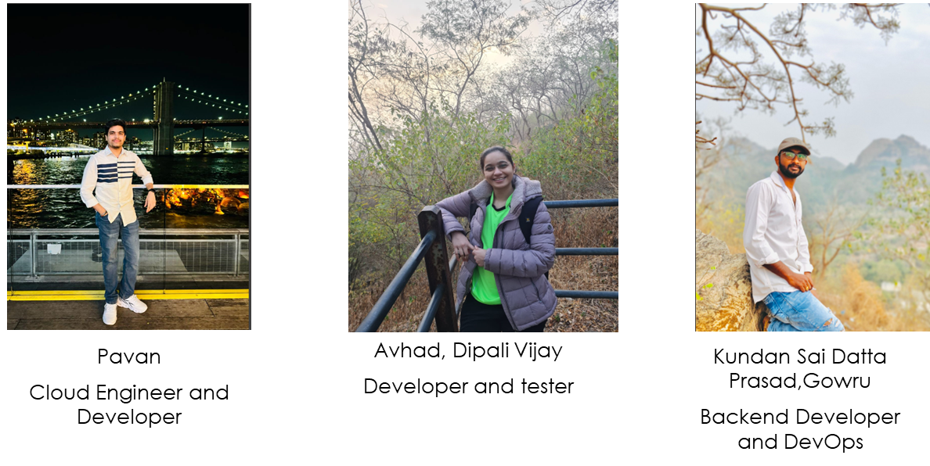
Team Member Roles

Slide 6
Improvements made from Professor's Feedback
Consistency in Color Palette
Uniform Placement of Titles
Incorporating Diagram in Algorithm Slide
Distinguishing between Task and Issue
Inclusion of User Stories in Backlogs
Enhancing Burndown Chart
Audio Check before Presentation

Slide 7
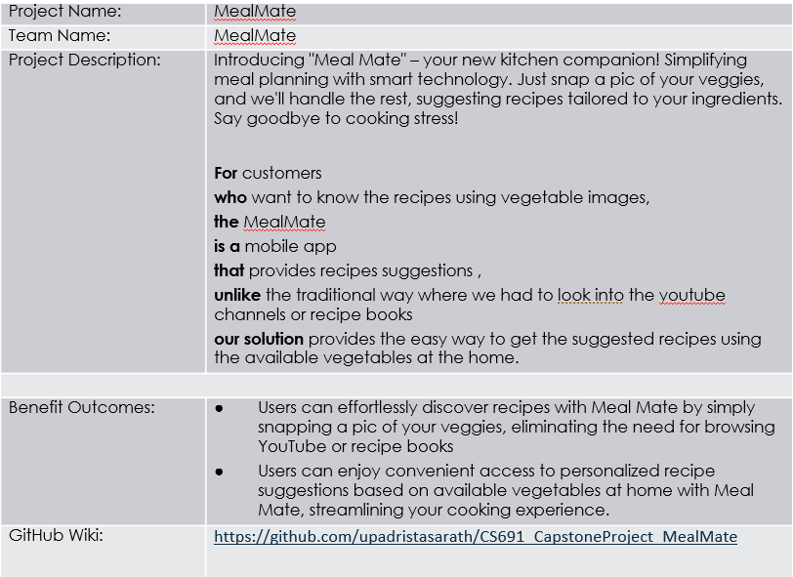
Project Description

Slide 8
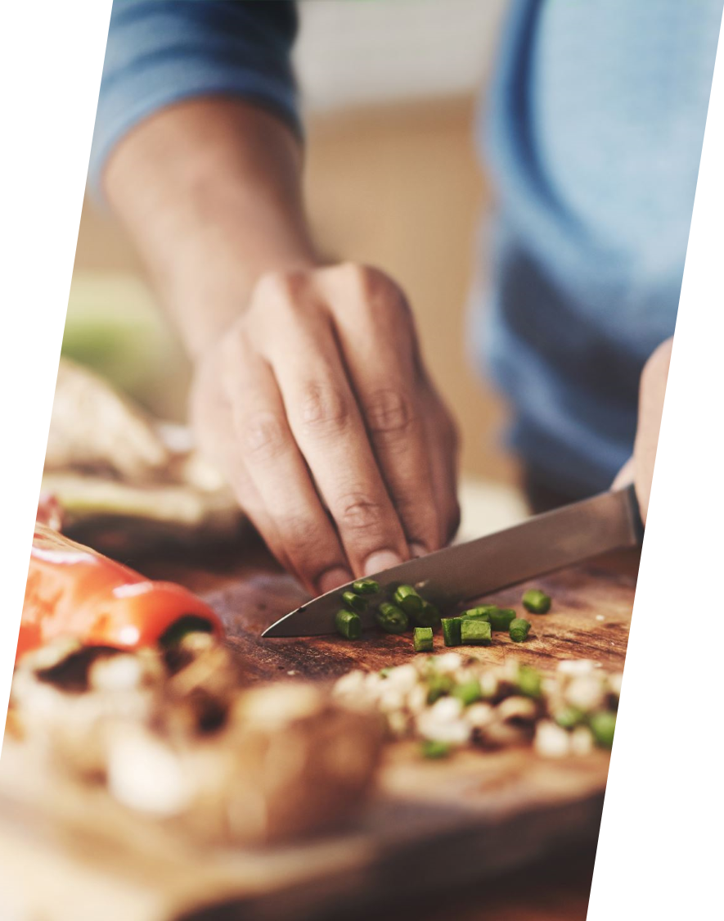
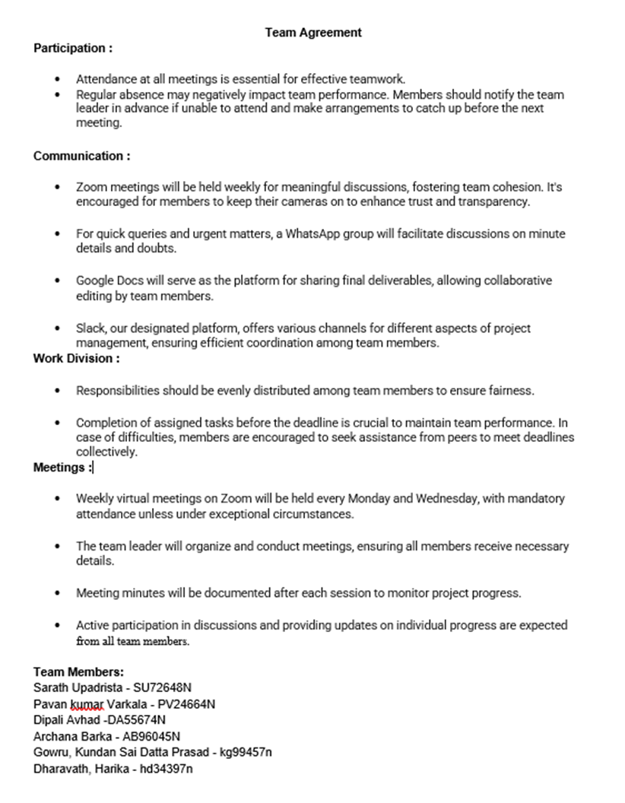
Team work Aggrement

Slide 9








Personas

Slide 10



Sarah
Sarah is a busy marketing executive who often struggles with meal planning due to her demanding job. She enjoys cooking but finds it challenging to make time for it amidst her busy schedule.
Age: 24
Occupation: Marketing Manager
Location: Dew Drive
Income Range: $45,000 - $139,999
GOALS
MOTIVATIONS
Find convenient solution for meal planning
Find tool to help her quickly and easily plan nutritious meals
Comfort
Convenience
Price
FRUSTRATIONS
PERSONALITY
INTERESTS
Frustrated by the lack of time to plan and prepare meals
often resorting to unhealthy takeout options due to her busy schedule
Helpful
Independent
Resourceful
Enjoys Experiments with recipes
Cooking
maintaining a healthy lifestyle

Slide 11

Michael
Michael is a recent college graduate who has just moved into his first apartment. He is eager to learn how to cook but feels overwhelmed by the variety of ingredients available at the grocery store.
Age: 25
Occupation: Recent College Graduate
Location: New York
Income Range: $55,000 - $139,999
GOALS
MOTIVATIONS
Improve cooking skills and become confident kitchen
Find tool to prepare recies easily
Comfort
Convenience
Price
FRUSTRATIONS
PERSONALITY
INTERESTS
Frustrated in lack of experience in the kitchen
often struggles to come up with meal ideas and ends up ordering takeout instead
Sportive
Motivated
Resourceful
interested to cook simple and nutritious meals to enjoy at home
improve culinary skills

Slide 12
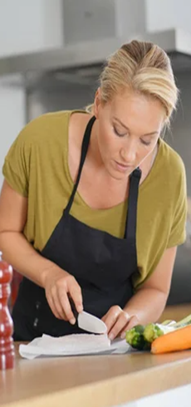
Emily
Emily is a dedicated stay-at-home mom who prioritizes providing healthy meals for her family. She wants to reduce food waste and find creative ways to incorporate vegetables into her family's diet.
Age: 35
Occupation: Stay-at-Home Mom
Location: Florida
Income Range: $55,000 - $239,999
GOALS
MOTIVATIONS
Find convenient solution for meal planning
Find tool to help her quickly and easily plan nutritious meals
Comfort
Convenience
Price
FRUSTRATIONS
PERSONALITY
INTERESTS
frustrated by the challenge of finding new and exciting recipes
feels guilty about wasting food
Helpful
Independent
Resourceful
passionate about cooking by finding new recipes
interested in nutrition

Slide 13
Minimal Viable Product (MVP)
The following are the features that we are covering in our MVP:
uLogin Screen
uSign in
uHome Page
uCamera screen
uProfile Screen
uHistory

Slide 14
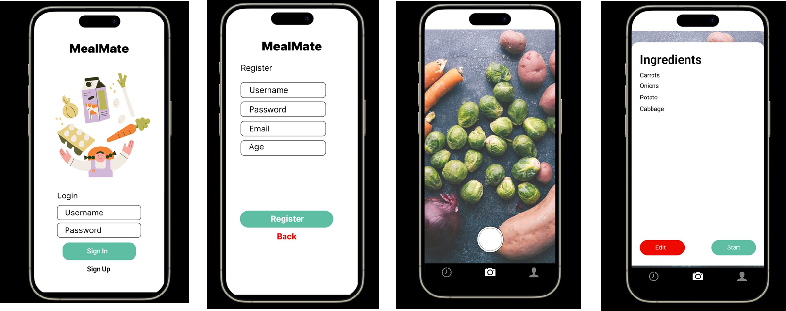
Minimal Viable Product (MVP)

Slide 15
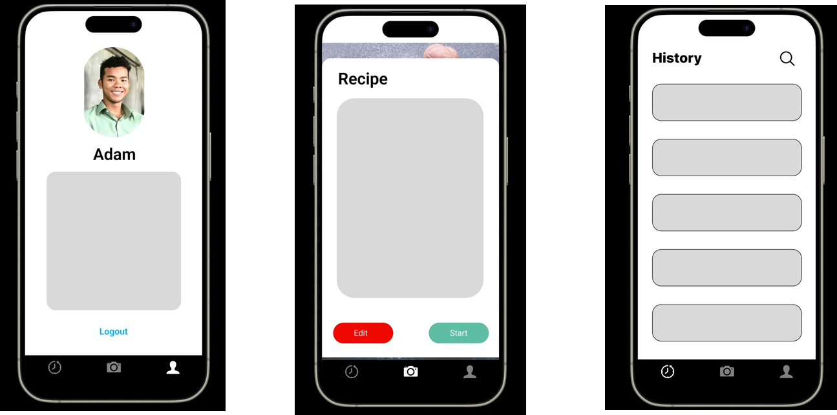
Minimal Viable Product (MVP)

Slide 16
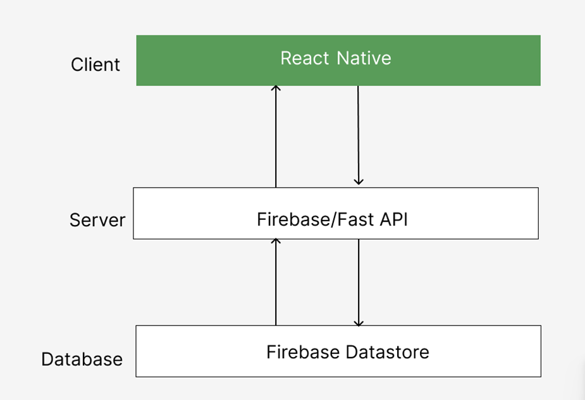
Technologies
React Native
Python
FastAPI
Firebase Datastore
ChatGPT API
Git/Github
JIRA

Slide 17
Algorithms
YOLOv7 (You Only Look Once version 7) is the latest version in a series of advanced deep learning models known for their impressive ability to detect objects in images and videos. This new version offers even better accuracy and speed, making it highly effective for real-time object detection. YOLOv7 stands out for its ability to quickly and accurately identify and classify multiple objects in photos or video feeds, which makes it a valuable tool for applications that need fast and reliable object detection, such as self-driving cars, security cameras, and industrial automation. Its enhanced performance, combined with its flexibility and ease of integration with existing systems, keeps YOLOv7 at the leading edge of object detection technology.

Slide 18
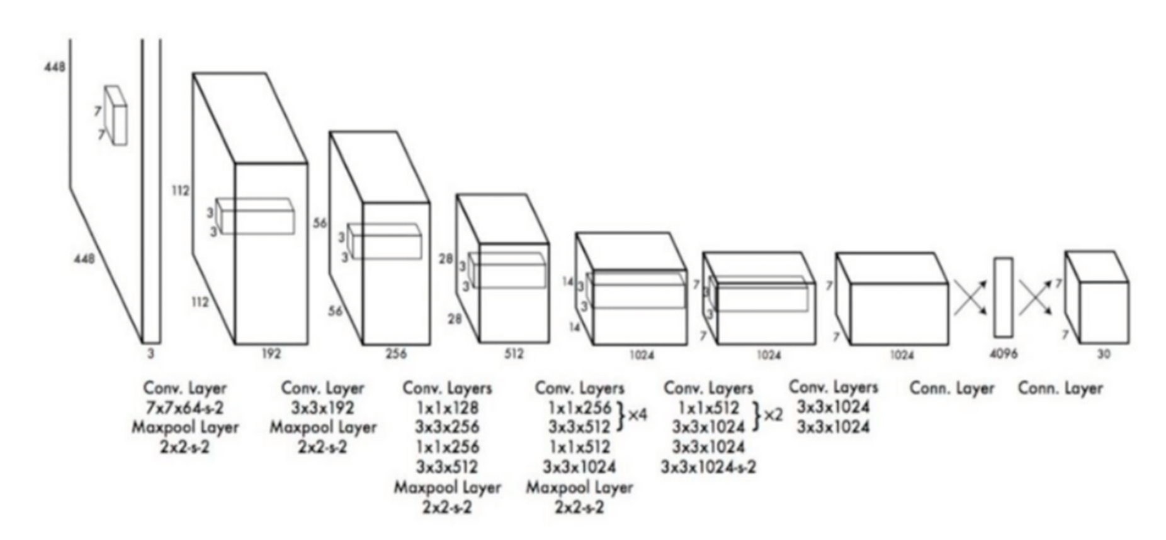
Algorithms

Slide 19

ARCHITECTURE DIAGRAM

Slide 20
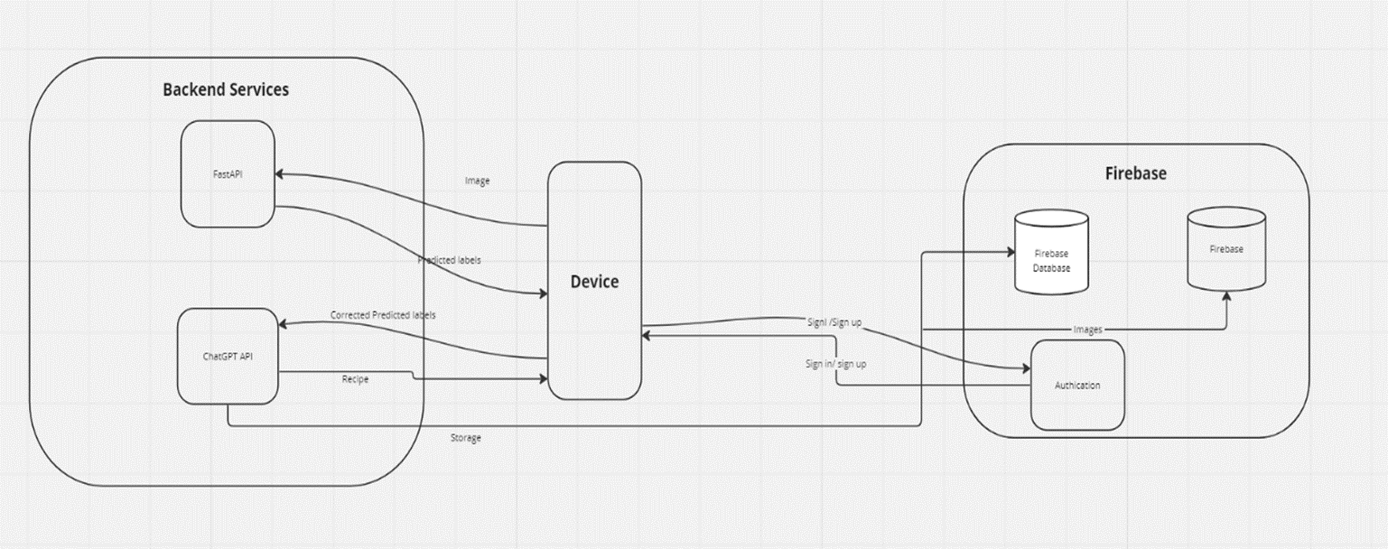
Conceptual Architecture Diagram

Slide 21
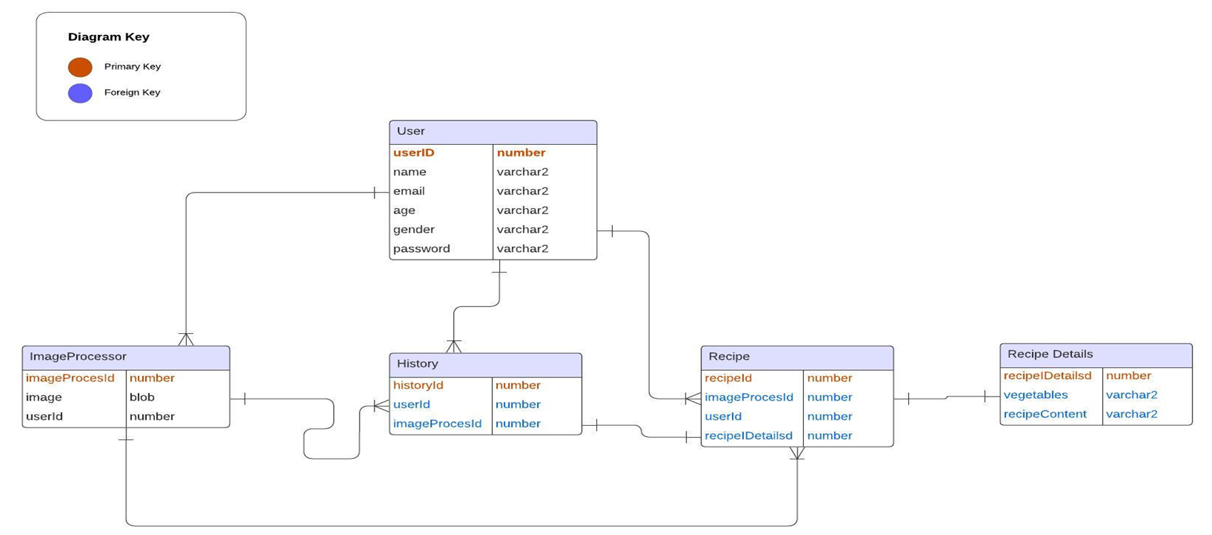
ER Diagram

Slide 22
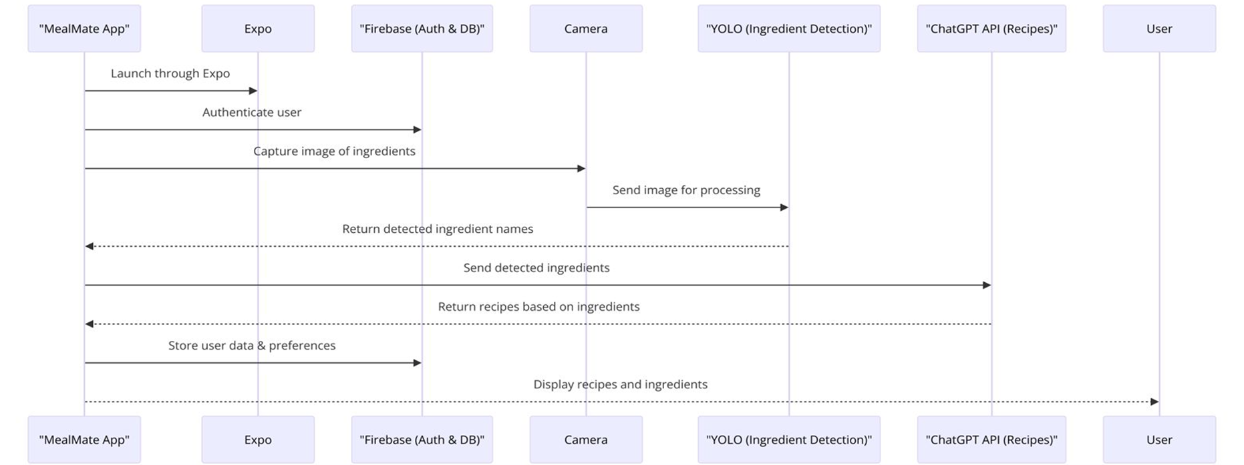
Sequence Architecture Diagram

Slide 23

Sprint 1-3 Recap

Slide 24
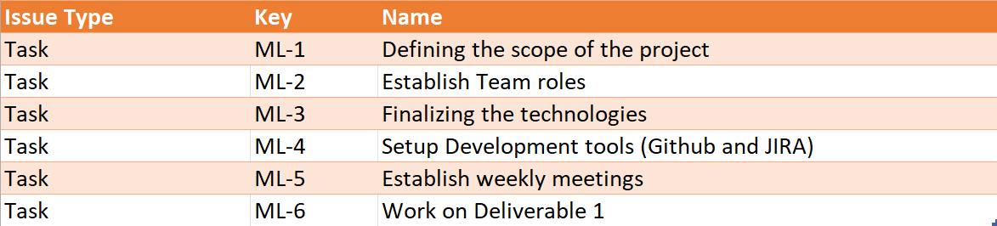
Sprint 1
In sprint 0 and 1 we choose the topic and our mobile application idea.
We created our schedule, and team working agreement and assigned each team member their roles.
We also set up our development tools which we used for 4 sprints to create, maintain and update our web application and communication.

Slide 25
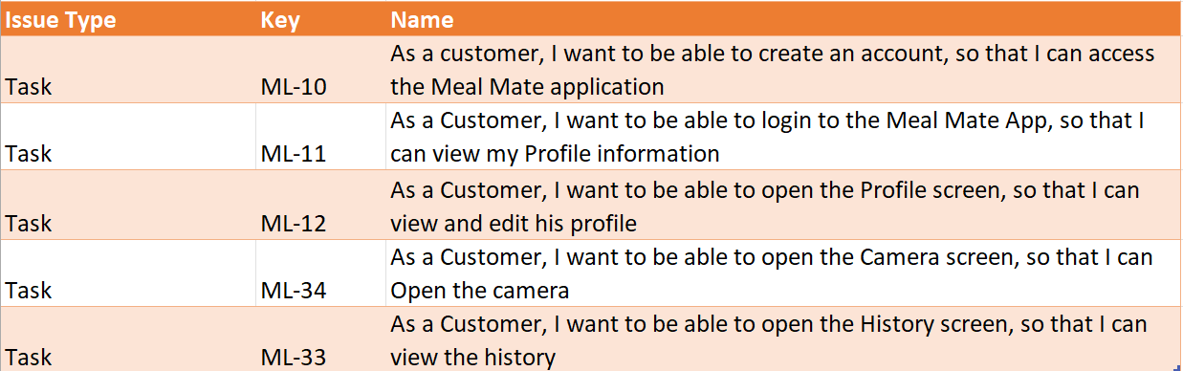
Sprint 2
In sprint 2 we have started the project with Minimum Viable Product (MVP)
We have used Figma to design the MVP screens

Slide 26
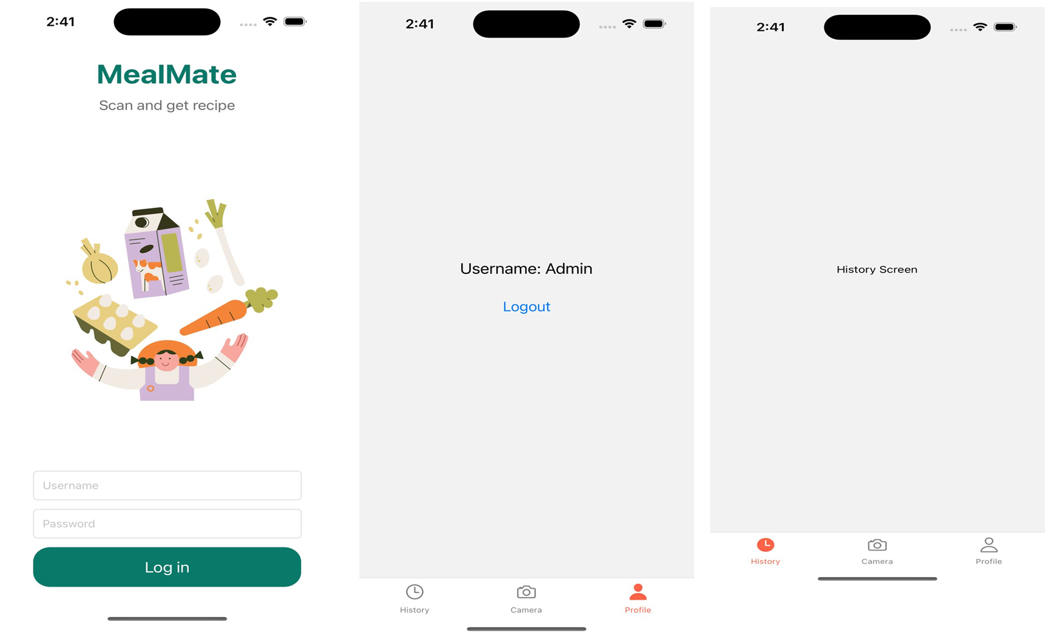
Sprint 2

Slide 27
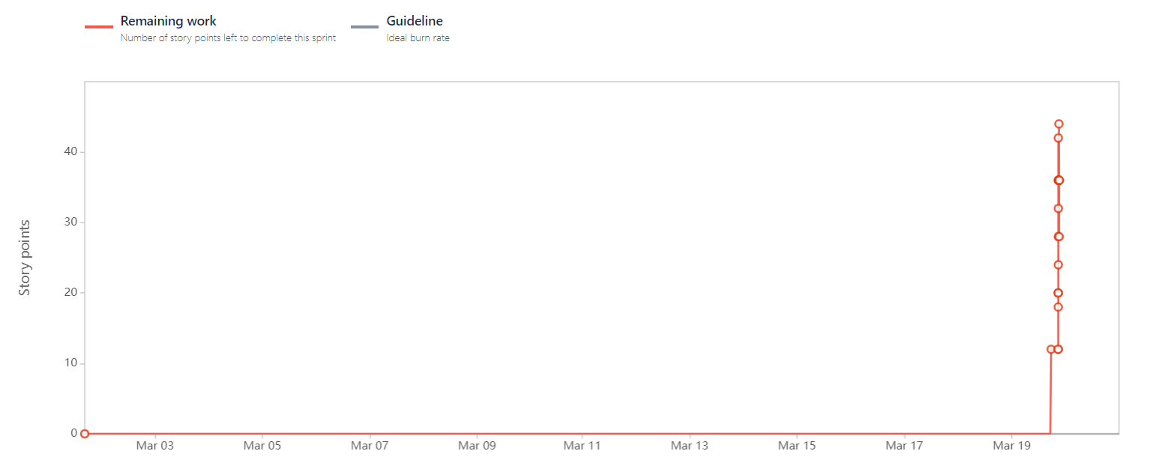
Sprint 2 Burndown chart

Slide 28
Sprint 3
In sprint 3 we created Registration page by integrating it with Firebase
We have created Profile screen, where user can update the Phone number
We have created history screen by listing down the history items

Slide 29
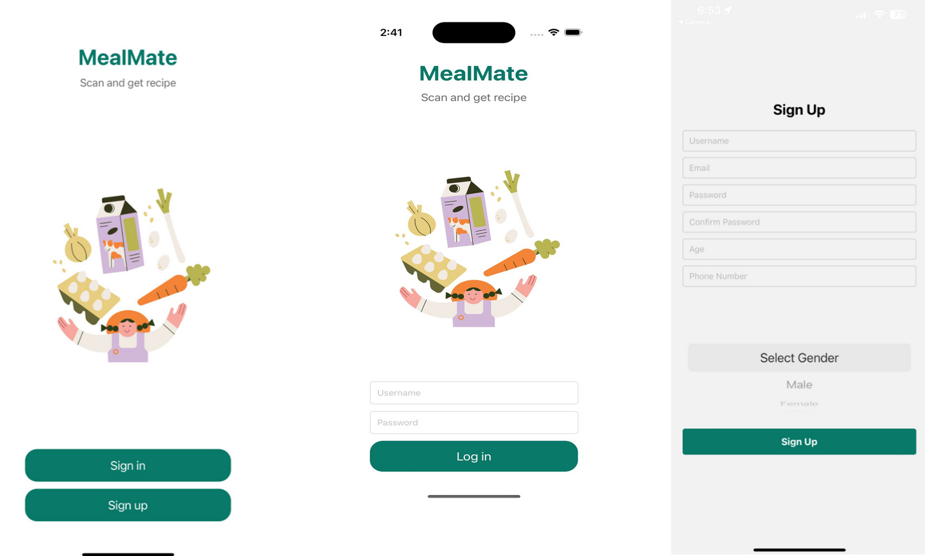
Sprint 3

Slide 30
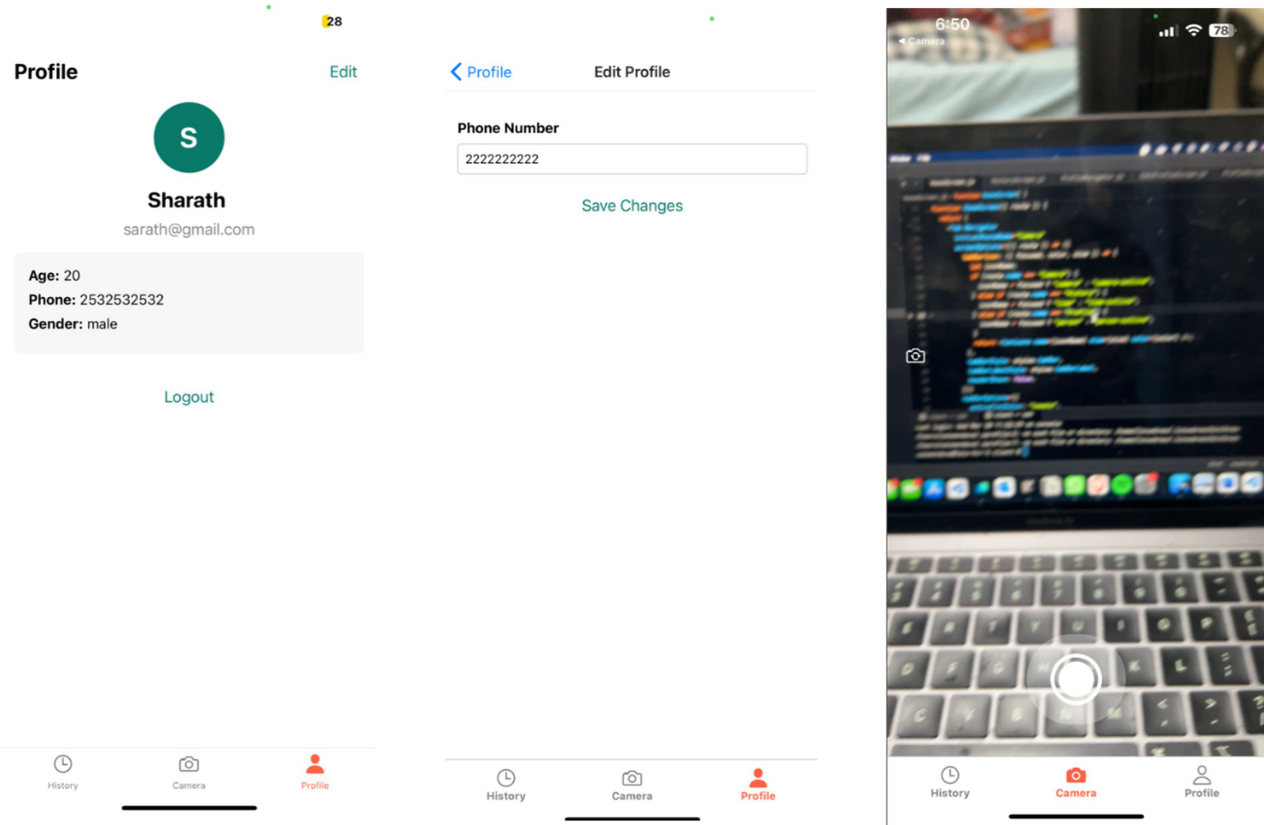
Sprint 3

Slide 31
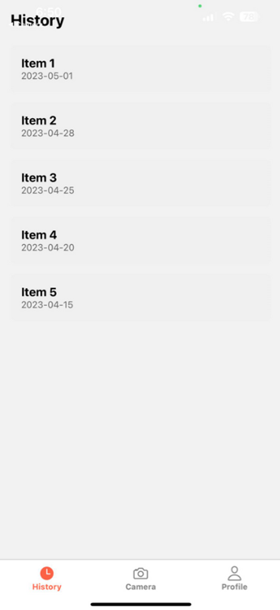
Sprint 3

Slide 32
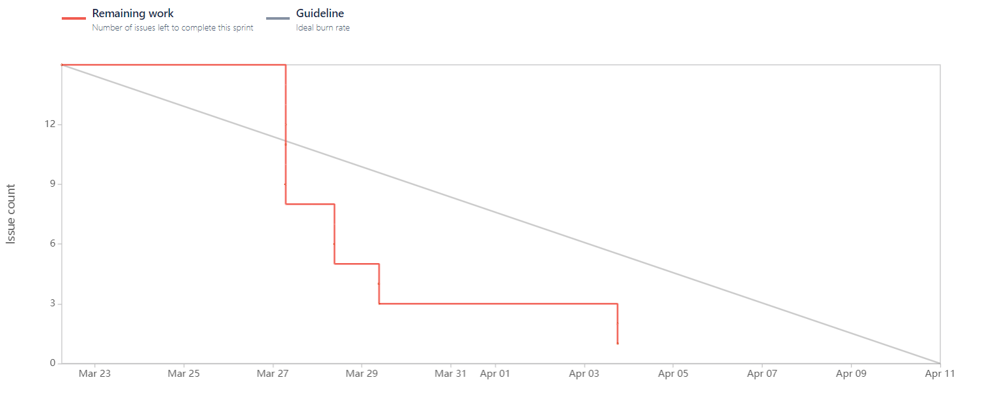
Sprint 3 Burndown chart

Slide 33
Improvements Made from Professor Feedback from Sprint 1 - 3
Added Personas Screen, which we missed in Sprint 1
Removed “How could we do things differently” section from Retrospective slide in Sprint 1
The slides order is followed as per the checklist in Sprint 2
We linked the test cases with User Stories ID’s, that link them with the corresponding stories
The user stories format was changed to “As a [user], I want [functionality], “so that” [benefit from it]

Slide 34
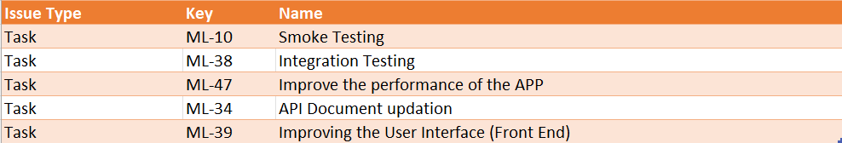
Sprint 3 Backlog

Slide 35
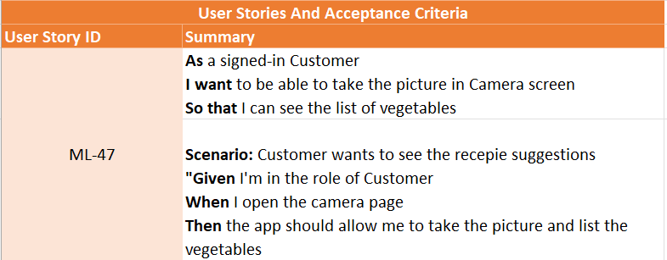
ACCEPTANCE CRITERIA AND USER STORIES

Slide 36
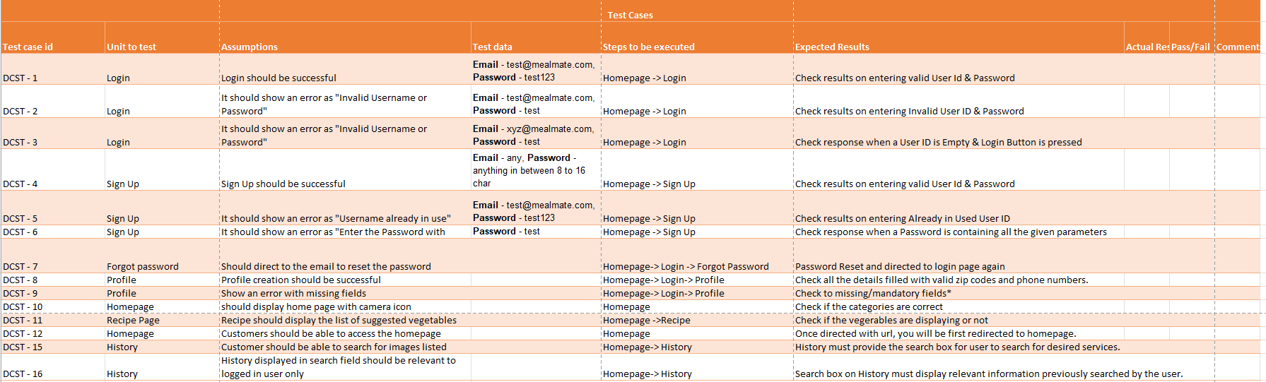
Test Cases

Slide 37
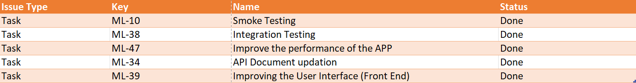
Stories/Task Completed And Not Completed

Slide 38

Metrics

Slide 39
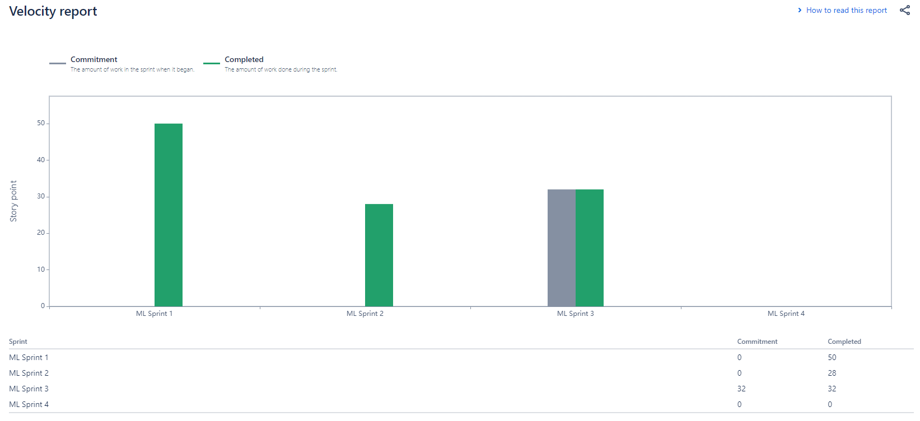
Team Members Velocity report

Slide 40
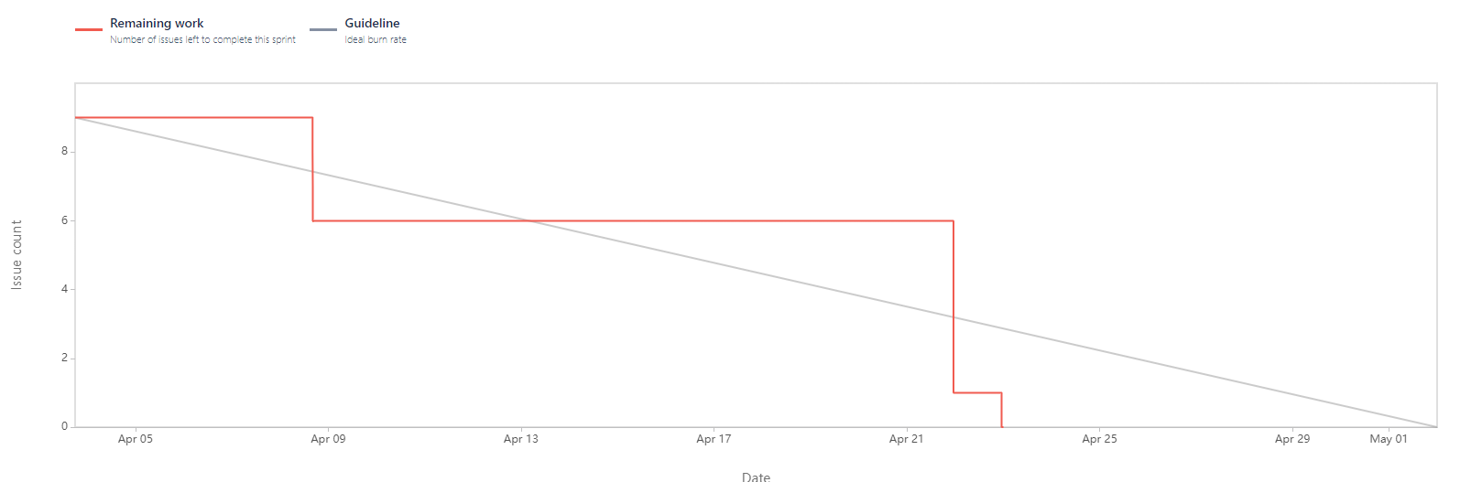
Sprint Burndown Chart

Slide 41

Completed/Committed Ratio

Slide 42

RETROSPECTIVE

Slide 43
WHAT WENT WELL
We kept in touch throughout the project to ensure everyone knew what to do and any issues were quickly resolved.
The team enjoyed working together.
We found creative ways to solve any problems that came up, helping the project run smoothly.
We delivered on schedule without any bugs.
We had a tight schedule, but we stayed organized and got everything done. Our brainstorming sessions for user stories really helped.
We planned well before starting, allowing us to break the project into smaller tasks and set realistic deadlines.

Slide 44
WHAT NEEDS IMPROVEMENT
We had to work with new technologies and tools, which was tough for some team members.
Sometimes we weren't all on the same page, which led to delays and confusion.
Some team members didn't know much about the subject, which made it hard to make good decisions and caused a few mistakes.
The process for giving feedback had issues, and it took a long time to review some topics.

Slide 45
NEXT STEPS
We can also use analytics on the survey results to understand user behavior and spot areas that need improvement.
We could offer training or resources to fill any knowledge gaps and keep everyone on the same page.
We should update the status of assigned tasks regularly.
To get users more involved, we can do public surveys to find out what people need and expect.

Slide 46
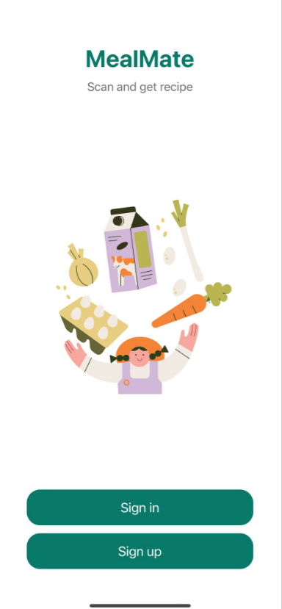
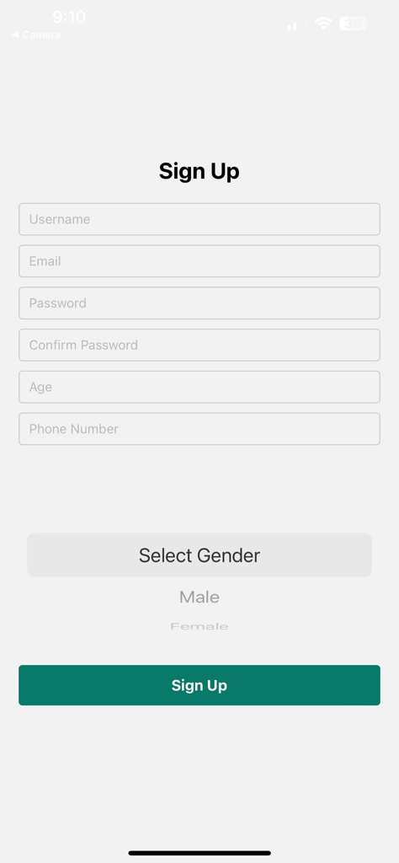
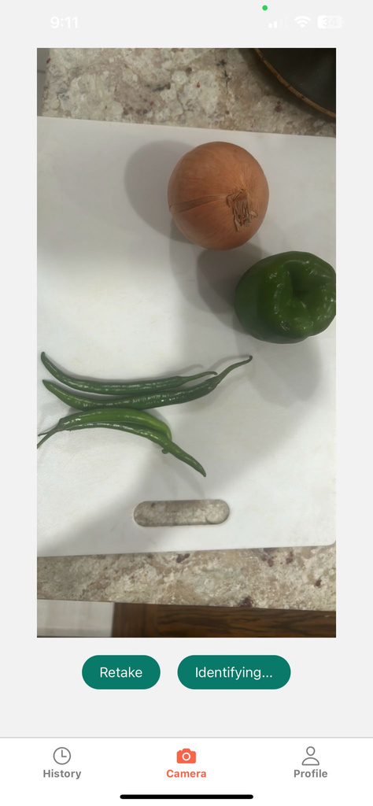
Project Demo

Slide 47
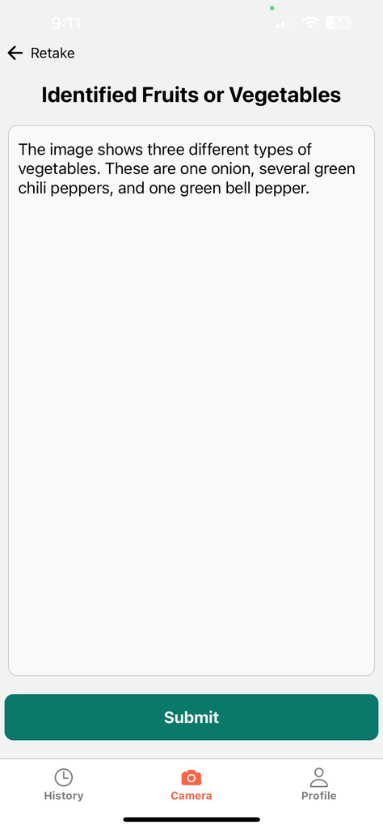
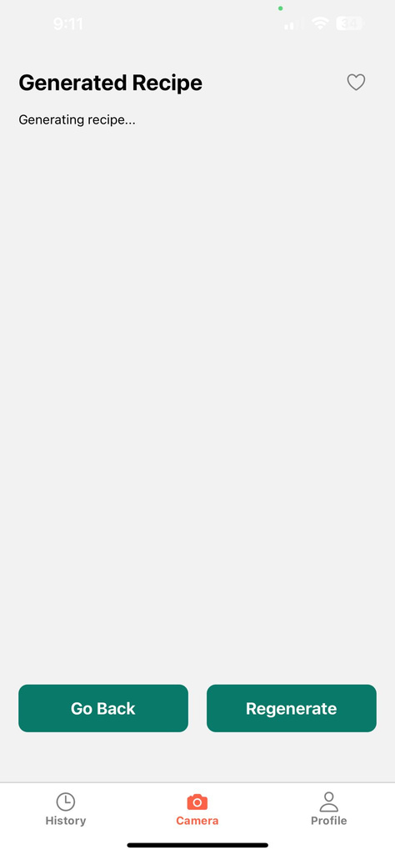
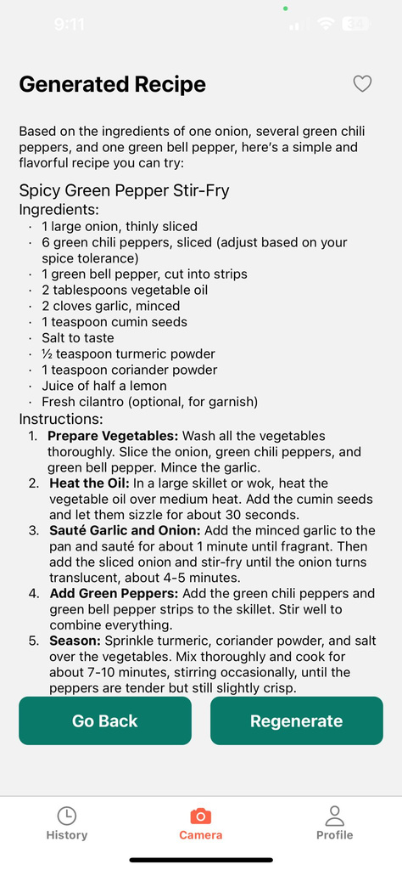
Project Demo

Slide 48
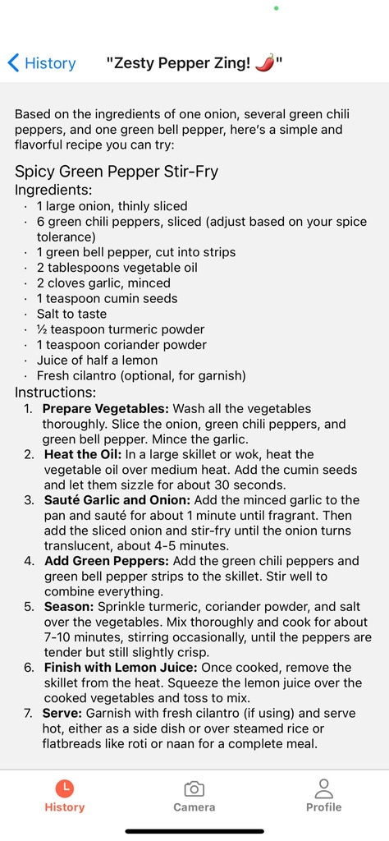
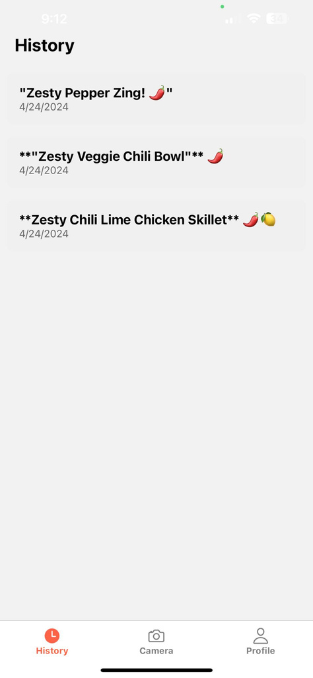
Project Demo

Slide 49
Links
Github Link
Git Hub URL
Technical Paper Link
Technical Paper
Deployment Manual Link
Deployment Manual

Slide 50
Future Scope
Advanced Recipe Recommendations: The app could use machine learning to improve recipe suggestions, considering users' past cooking history, dietary preferences, and food allergies. This personalized approach can make meal planning even more convenient.
Shopping List and Inventory Management: Include a feature to automatically generate a shopping list based on planned recipes. The app could also track the inventory of ingredients, alerting users when they need to restock specific items.
Nutritional Information and Health Tracking: Offer detailed nutritional information for each recipe and allow users to set dietary goals. Integration with fitness trackers or health apps could provide a comprehensive view of users' health and wellness.
Social Sharing and Community Engagement: Enable users to share recipes, cooking tips, and photos of their meals with a broader community. Creating a space for users to interact can foster a sense of community and inspire creativity in the kitchen.
Voice Command Integration: Incorporate voice recognition technology to allow hands-free operation. This can make it easier for users to interact with the app while cooking.
Integration with Smart Kitchen Devices: Connect with smart appliances like ovens, refrigerators, or instant pots to streamline cooking processes. The app could send recipe instructions directly to these devices, simplifying cooking.
Dietary Plans and Custom Meal Prep: Introduce features to create and manage weekly meal plans. Users can choose meal plans based on their dietary goals, lifestyle, or cuisine preferences.
Localized Recipe Suggestions: Offer recipes based on local cuisine, supporting users from different regions. This could enhance cultural relevance and encourage users to try new dishes.

Slide 51
Live Application Demo

Slide 52




Thank you!

